Slide 1
PROBABILITY
By:-
Naveen Kumar Jain
(Aptitude Trainer)

Slide 2

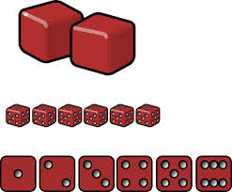
Random Experiment :
It is an experiment in which all the possible
results are known in advance but they cannot be predicted with certainty.
For eg : Rolling of a Die
What is a random experiment ?
1,
2,
3,
4,
5,
6
Possible Results
What is an outcome ?
The result of a random experiment.
Outcome
Number of all possible outcomes = 6
Here, we assume that each outcome is likely to occur equally as other.
Hence,
1,
2,
3,
4,
5,
6
Equally Likely Outcomes

Slide 3
All Possible Outcome of
Tossing Coin Experiment

Slide 4
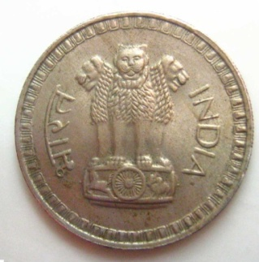
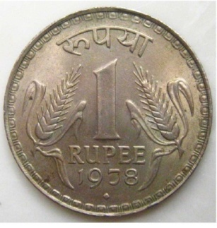
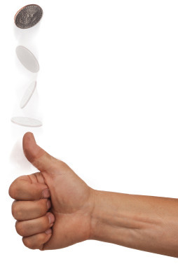
A Coin is Tossed
H
T
All possible outcomes are H, T
Number of all possible outcomes = 2

Slide 5
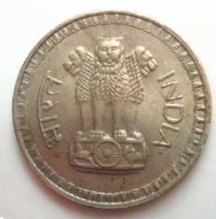

2 Coins are Tossed
Together
Result on first coin
Result of both experiments are same
Result on second coin
Result on first coin
Result on second coin
1 Coin is tossed twice
Result on first coin
HH, HT, TH, TT
Result on first coin
Result on second coin
Result on second coin
Number of all possible outcomes = 4

Slide 6

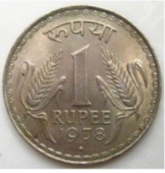

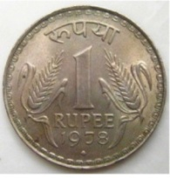



Result on
Result on
Result on
3 Coins are Tossed Together / 1 Coin is tossed thrice
1st coin/
1st time
2nd coin/
2nd time
3rd coin/
3rd time
1st coin/
1st time
2nd coin/
2nd time
3rd coin/
3rd time
Shift the position of T
One more time
So in all we have 8 outcomes
Start with HHH
Introduce T inthe end
Shift the position of T
Similarly if we start with TTT and shift the position of H we will get 4 more outcomes
Number of all possible outcomes = 8
RULE TO WRITE POSSIBLE OUTCOMES
* Write possible outcomes of 2 coins 2 times
* In first time put H as result of 3rd coin
* In second time put T as result of 3rd coin
HH , HT , TH , TT ,
H
H
H
H
T
T
HH , HT , TH , TT
T
T

Slide 7
All Possible Outcome of
Throwing Die Experiment

Slide 8
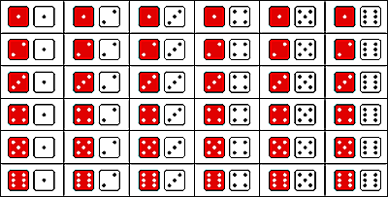
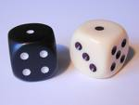
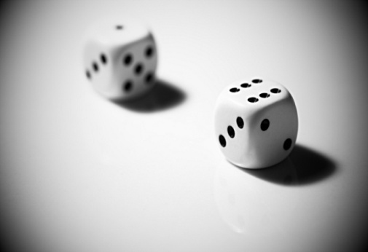
When Two Dice are Thrown together
Similarly on 1st die 2 & on 2nd die it may be 1/2/3/4/5/6
Similarly on 1st die 5 & on 2nd die it may be 1/2/3/4/5/6
Similarly on 1st die 3 & on 2nd die it may be 1/2/3/4/5/6
Similarly on 1st die 6 & on 2nd die it may be 1/2/3/4/5/6
Similarly on 1st die 4 & on 2nd die it may be 1/2/3/4/5/6
on 1st die 1 & on 2nd die 1
on 1st die 1 & on 2nd die 2
on 1st die 1 & on 2nd die 3
on 1st die 1 & on 2nd die 4
on 1st die 1 & on 2nd die 5
on 1st die 1 & on 2nd die 6
Consider the colour
of 1st die as red & of 2nd die as white
In this experiment the possible outcomes has to be written as seen here, that is 6 outcomes in every row
(1,1),
(1,2),
(1,3),
(1,4),
(1,5),
(1,6),
(2,1), (2,2), (2,3), (2,4), (2,5), (2,6),
(3,1), (3,2), (3,3), (3,4), (3,5), (3,6),
(4,1), (4,2), (4,3), (4,4), (4,5), (4,6),
(5,1), (5,2), (5,3), (5,4), (5,5), (5,6),
Number of all possible outcomes = 36
(6,1), (6,2), (6,3), (6,4), (6,5), (6,6)

Slide 9
For Coin and dice to know total no. of
outcomes we can remember as follows :
Outcome of 3rd coin
Outcome of 1st coin
Outcome of 2nd die
Outcome of 2nd coin
Outcome of 1st coin
Outcome of 2nd coin
Total no. of outcomes in 1 coin = 2
Total no. of outcomes in 2 coins = 2 × 2 = 4
Total no. of outcomes in 3 coins = 2 × 2 × 2 = 8
Total no. of outcomes in n coin = 2
Total no. of outcomes in 1 die = 6
Total no. of outcomes in 2 dice = 6 × 6 = 36
Total no. of outcomes in n dice=6
Outcome of 1st die
n
n

Slide 10
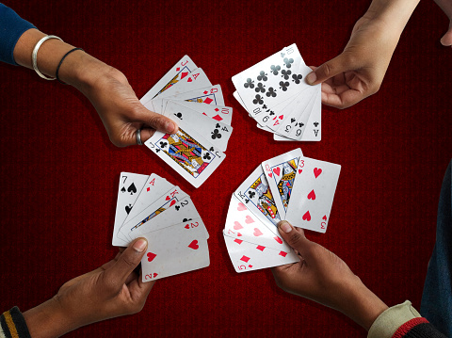
Outcome of Playing cards

Slide 11


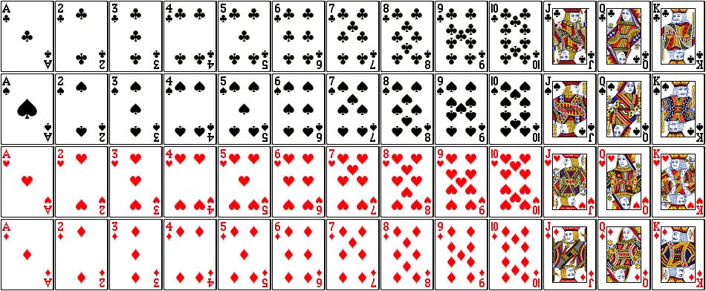


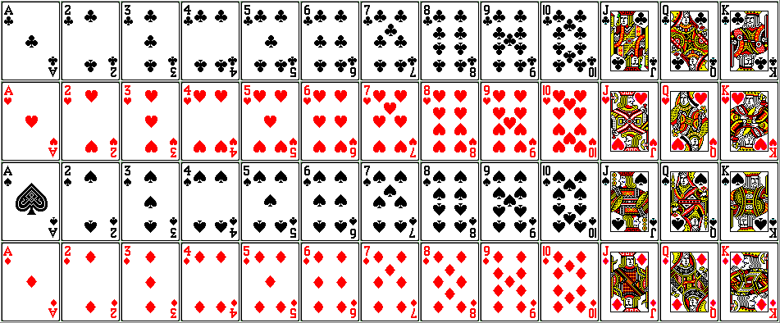
Playing Cards
1. There are total 52 cards.
2. It comprises of 13 cards each of the four suits.
3. There are total 26 black cards and 26 red cards.
4. Each suit includes 3 face cards: King , Queen and
Jack, a total of 12 face cards.
Notes:
^

Slide 12


PROBABILITY OF AN EVENT
Number of outcomes favourable to E
P(E) =
Number of all possible outcomes of the experiment
An event is denoted by capital letter.
Bracket stands for of
P stands for probability
If $\overline{A}$ denotes (not-A)
then $P(\overline{A}) = 1 − P(A).$

Slide 13
NOTE :
Probability of impossible event = 0
Probability of certain event = 1
Probability of any event lies between 0 and 1
Probability of any event cannot be negative
or it cannot be greater than 1

Slide 14
In all the questions of Probability, there are three steps:
Step 1:
Find total number of trials
Step 2:
Find the number of elements favorable for the event
number of elements favorable for the event
Step 3:
Probability of any event
=
Total number of trails

Slide 15
SOME MORE CONCEPT
1. AND - Whenever we use AND as the natural conjunction joining two separate parts of even definitions, we replace the AND by the multiplication sign.
E.g.: If probability of passing in an exam is 1/2 for A and probability of passing the same is 1/3 for B then probability of passing of A and B both is P(A) x P(B)
i.e. 1/2 x 1/3 = 1/6
2. OR – Whenever we use OR as the natural conjunction joining two separate parts of the event definition, we replace the OR by the addition sign.
E.g.: If we have the probability of A winning a race as 2/3 and that of B as 1/6 then probability that either A or B wins a race is given by P(A) + P(B).
i.e. 2/3 + 1/6 = 5/6
3. ATLEAST is minimum to maximum.
5. Selection/Picking is combination.
4. ATMOST is maximum to minimum.

Slide 16
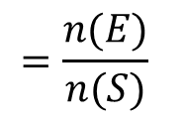
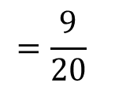
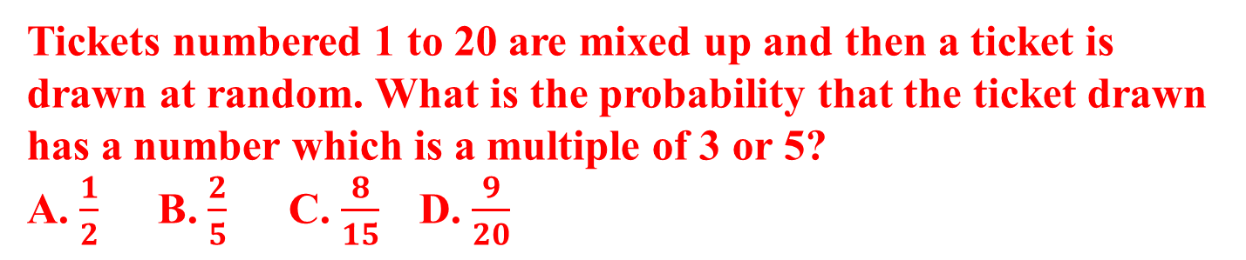


PRACTICE QUESTION
Tickets numbered 1 to 20 are mixed up and then a ticket is drawn at random. What is the probability that the ticket drawn has a number which is a multiple of 3 or 5?
A. $\frac{1}{2}$ B. $\frac{2}{5}$ C. $\frac{8}{15}$ D. $\frac{9}{20}$
Here, S = {1, 2, 3, 4, ...., 19, 20}.
$$n\left(S\right)=20$$
Let E = event of getting a multiple of 3 or 5 =
{3, 6 , 9, 12, 15, 18, 5, 10, 20}.
$$n\left(E\right)=9$$
$$=\frac{n(E)}{n(S)}$$
Required probability
$$=\frac{9}{20}$$

Slide 17
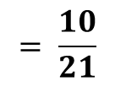
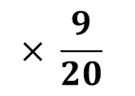
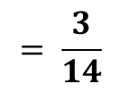
PROBABILITY
1. A box contains 21 balls numbered 1 to 21. A ball is drawn and then another ball is drawn without replacement. What is the probability that both balls are even numbered?
A. 2/7 B. 8/21 C. 3/14 D. 5/21
$$= \frac{10}{21}$$
$$× \frac{9}{20}$$
P
$$= \frac{3}{14}$$

Slide 18
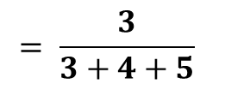
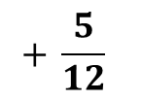
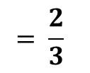
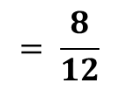
2. There are 3 green, 4 orange and 5 white color bulbs in a bag. If a bulb is picked at random, what is the probability of having either a green or a white bulb?
A. 3/4 B.2/3 C.4/3 D.2/5
$$= \frac{3}{3+4+5}$$
$$+ \frac{5}{12}$$
P
$$= \frac{8}{12}$$
$$= \frac{2}{3}$$

Slide 19
3. A box contains slips with numbers from 1 to 50 written on them. A slip is drawn and replaced. Then another slip is drawn and after replacing another slip is drawn. What is the probability that an even number appears on the first draw, an odd number on the second draw and a number divisible by 3 on the third draw.
A.1/25 B.2/25 C.8/25 D.2/25

Slide 20
4. When 4 fair coins are tossed together what is the probability of getting at least 3 heads?
A. 1/4 B. 3/4 C. 5/16 D. 3/8

Slide 21
5. A committee of 3 members is to be made out of 6 men and 5 women. What is the probability that the committee has at least two women?
A. 10/33 B. 14/33 C. 14/15 D. 13/25

Slide 22
6. There are 15 boys and 10 girls in a class. If three students are selected at random, what is the probability that 1 girl and 2 boys are selected?
A. 1/40 B.1/2 C.21/46 D.7/41

Slide 23
7. Three dice are thrown together. Find the probability of getting a total of at least 6?
A.13/216 B.103/208 C.103/108 D.36/103

Slide 24
8. A bag contains 6 pink and 5 yellow balls. One ball is drawn randomly. What is the probability that the ball drawn is Pink?
A. 5/11 B. 1/2 C. 3/11 D. 6/11

Slide 25
9. In a box there are 10 apples and 2/5th of the apples are rotten. If three apples are taken out from the box, what will be the probability that at least one apple is rotten.
A. 3/4 B. 5/6 C. 9/10 D. 8/13

Slide 26
10. A bag contains 5 yellow and 2 green and 3 red colour dice. If one dice from the bag are chosen at random, what is the probability that dice is either yellow or red colour?
A. 3/4 B. 4/5 C. 3/10 D. 7/10

Slide 27
11 A bag contains 5 red and 6 black marbles. Two are drawn without replacement. What is the probability that both are red?
A. 2/11 B. 5/11 C. 6/11 D. 1/11

Slide 28
12 A bag contains 5 blue and 6 green balls. Two are drawn without replacement. Find the probability that they are the same color.
A. 60/36 B. 16/36 C. 9/36 D. 12/36

Slide 29
13 Two fair dice are rolled. The score is the larger of the number showing. Find the probability that the score is 1?
A. 0 B. 1/36 C. 1/3 D. 1/6

Slide 30
14 Two fair dice are thrown. Find the probability that the sum is 7
A. 1/6 B. 7/36 C. 1/18 D. 2/3

Slide 31
15 Two children A and B each pick a random single digit from 1 to 9. Find the probability that they pick the same number.
A. 1/9 B. 1/81 C. 8/9 D. 5/36

Slide 32
16 Ram draws one card at random from a pack of 52 cards. What is the probability that the card drawn is a face card (jack, queen and king only)?
A. 3/13 B. 3/15 C. 3/17 D. 3/19

Slide 33
17 In a bag, there are 8 red, 7 yellow and 6 green balls. If one ball is picked up at random, what is the probability that it is neither red nor green?
A. 1/4 B. 1/3 C. 1/5 D. 1/2

Slide 34
18 In a group of students, there are 15 boys and 10 girls. If three students are selected at random, what is the probability that 1 girl and 2 boys are selected?
A. 21/46 B. 21/36 C. 21/56 D. 21/26

Slide 35
19 A man draws two cards at random from a pack of 52 cards. What is the probability that one is a spade and the other is a heart?
A. 13/105 B. 13/102 C. 13/110 D. 13/108

Slide 36
20 A card is drawn from a pack of 52 cards. What is the probability of getting a king of heart or a queen of club?
A. 1/22 B. 1/24 C. 1/26 D. 1/28

Slide 38



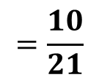
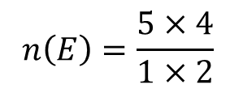
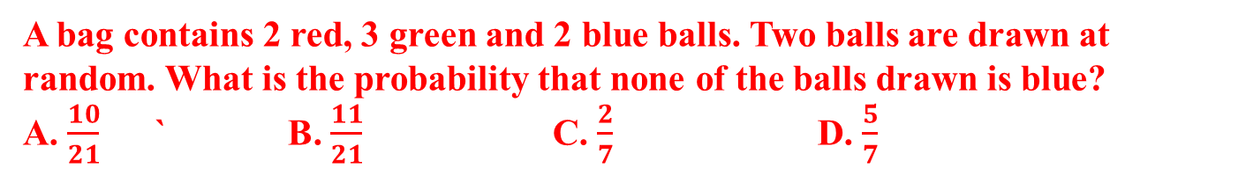



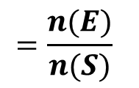
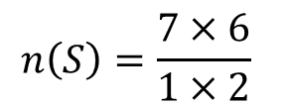
PRACTICE QUESTION
A bag contains 2 red, 3 green and 2 blue balls. Two balls are drawn at random. What is the probability that none of the balls drawn is blue?
A. $\frac{10}{21}$ ` B. $\frac{11}{21}$ C. $\frac{2}{7}$ D. $\frac{5}{7}$
Here, Total number of balls
$$=7 Balls$$
$$=2R+3G+2B$$
Let n(S) Number of ways of drawing 2 balls out of 7
$$n\left(S\right)={{}_{}^{7}C}_{2}$$
$$n\left(S\right)=\frac{7×6}{1×2}$$
$$=21$$
Let E = Event of drawing 2 balls, none of which is blue.
$$n\left(E\right)={{}_{}^{5}C}_{2}$$
$$n\left(E\right)=\frac{5×4}{1×2}$$
$$=10$$
$$=\frac{n(E)}{n(S)}$$
$$=\frac{10}{21}$$
Required probability

Slide 39
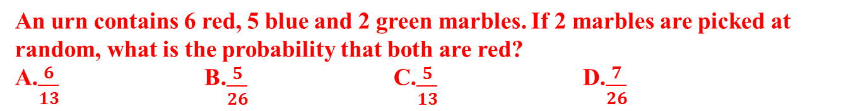
PRACTICE QUESTION
An urn contains 6 red, 5 blue and 2 green marbles. If 2 marbles are picked at random, what is the probability that both are red?
A.$\frac{6}{13}$ B.$\frac{5}{26}$ C.$\frac{5}{13}$ D.$\frac{7}{26}$
There are 6 red
, 5 blue
, 2 green marbles.
Ans B
Total Number of marbles=
6+5+2
=13
Total Number of outcomes for picking 2 marbles
= ¹³C₂
13×12
=
=
78
1×2
Favorable Number of outcomes for picking 2 red marbles
= ⁶C₂
6×5
=
=
15
1×2
n(E)
15
5
P
=
=
=
n(S)
78
26

Slide 40

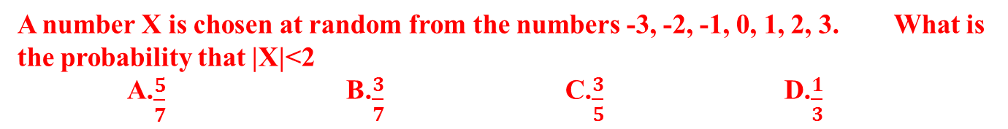



PRACTICE QUESTION
A number X is chosen at random from the numbers -3, -2, -1, 0, 1, 2, 3. What is the probability that |X|<2
A.$\frac{5}{7}$ B.$\frac{3}{7}$ C.$\frac{3}{5}$ D.$\frac{1}{3}$
Ans B
All possible outcomes are
$$\{−3,−2,−1,0,1,2,3\}$$
Total number of outcomes
$$n(S)=7$$
Favorable outcomes for |X|<2
$$\left\{−1,0,1 \right\}$$
Number of favorable outcomes
$$n(E)=3$$
n(E)
3
P
=
=
n(S)
7

Slide 41
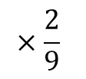
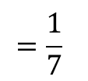
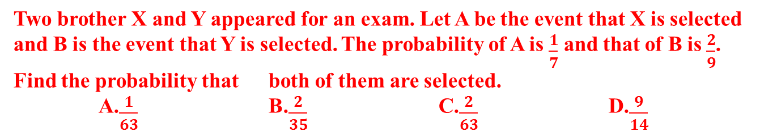

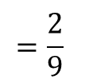
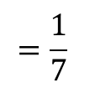
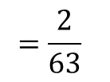
PRACTICE QUESTION
Two brother X and Y appeared for an exam. Let A be the event that X is selected and B is the event that Y is selected. The probability of A is $\frac{1}{7}$ and that of B is $\frac{2}{9}$. Find the probability that both of them are selected.
A.$\frac{1}{63}$ B.$\frac{2}{35}$ C.$\frac{2}{63}$ D.$\frac{9}{14}$
Given
$$=\frac{1}{7}$$
Ans C
P(x) = Probability of A being selected
$$=\frac{2}{9}$$
P(y) = Probability of B being selected
So, Probability of both being selected is
$$=P(x)×P(y)$$
$$=\frac{1}{7}$$
$$×\frac{2}{9}$$
$$=\frac{2}{63}$$

Slide 42
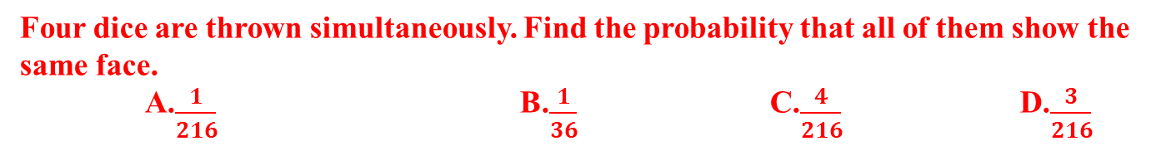
PRACTICE QUESTION
Four dice are thrown simultaneously. Find the probability that all of them show the same face.
A.$\frac{1}{216}$ B.$\frac{1}{36}$ C.$\frac{4}{216}$ D.$\frac{3}{216}$
Total number of outcomes when 4 dies are thrown
=6
× 6
× 6
× 6
Ans A
Let E is the event for favorable outcomes for all of them show the same face.
{ (1,1,1,1)
,(2,2,2,2)
,(3,3,3,3)
,(4,4,4,4)
,(5,5,5,5)
,(6,6,6,6) }
Number of favorable outcomes are
=6
n(E)
6
1
P
=
=
=
n(S)
6× 6× 6× 6
6× 6× 6
1
=
Ans A
216

Slide 43
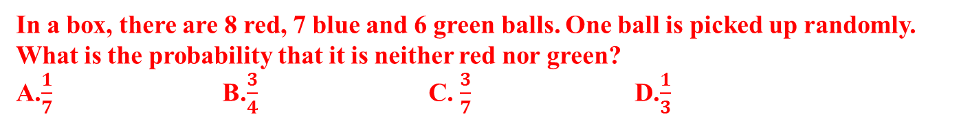
PRACTICE QUESTION
In a box, there are 8 red, 7 blue and 6 green balls. One ball is picked up randomly. What is the probability that it is neither red nor green?
A.$\frac{1}{7}$ B.$\frac{3}{4}$ C. $\frac{3}{7}$ D.$\frac{1}{3}$
There are 8 red
, 7 green
, 6 blue balls.
Ans D
Total Number of balls=
8+7+6
=21
Total Number of outcomes for picking 1 balls
=
21
Let E is the event of that ball drawn is neither red nor green balls
Favorable Number of outcomes for event E
=7
n(E)
7
1
P(E)
=
=
=
n(S)
21
3

Slide 44
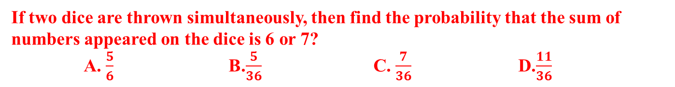
PRACTICE QUESTION
If two dice are thrown simultaneously, then find the probability that the sum of numbers appeared on the dice is 6 or 7?
A. $\frac{5}{6}$ B.$\frac{5}{36}$ C. $\frac{7}{36}$ D.$\frac{11}{36}$
Ans D
Total number of outcomes for throwing two dice
=36
Favorable outcomes for getting a sum of 6
{(1,5)( 2,4) (3,3) (4,2) (5,1)}
Favorable outcomes for getting a sum of 7
{(1,6)( 2,5) (3,4) (4,3) (5,2) (6,1)}
Favorable outcomes for getting a sum of 7
=5+6
=11
n(E)
11
P(E)
=
=
n(S)
36

Slide 45
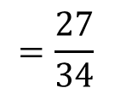
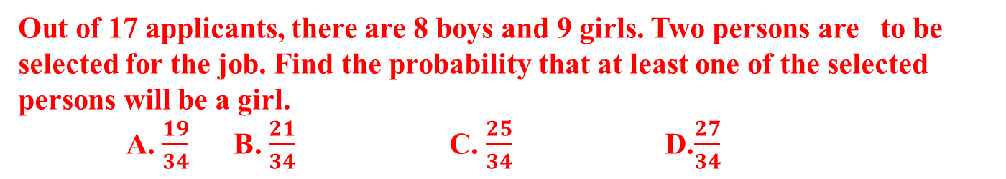




PRACTICE QUESTION
Out of 17 applicants, there are 8 boys and 9 girls. Two persons are to be selected for the job. Find the probability that at least one of the selected persons will be a girl.
A. $\frac{19}{34}$ B. $\frac{21}{34}$ C. $\frac{25}{34}$ D.$\frac{27}{34}$
The events of selection of two person is redefined as
Ans D
(i) first is a girl AND second is a boy
= $\left(\frac{8}{17}×\frac{9}{16}\right)$
OR
+
$\left(\frac{9}{17}×\frac{8}{16}\right)$
(ii) first is boy AND second is a girl
OR
+
(iii) first is a girl AND second is a girl.
$\left(\frac{9}{17}×\frac{8}{16}\right)$
$=\frac{9}{34} +\frac{9}{34} +\frac{9}{34}$
$$=\frac{27}{34}$$

Slide 46
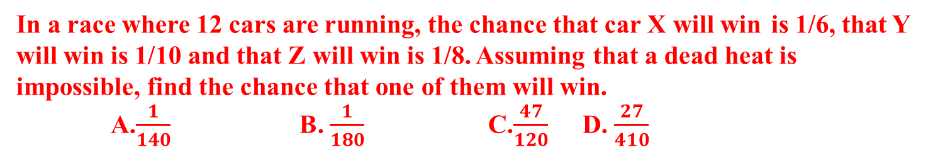
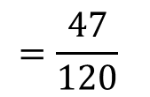

PRACTICE QUESTION
In a race where 12 cars are running, the chance that car X will win is 1/6, that Y will win is 1/10 and that Z will win is 1/8. Assuming that a dead heat is impossible, find the chance that one of them will win.
A.$\frac{1}{140}$ B. $\frac{1}{180}$ C.$\frac{47}{120}$ D. $\frac{27}{410}$
Here, all the events are mutually exclusive
So, required probability = P(X) + P(Y) + P(Z)
$=\frac{1}{6} +\frac{1}{10} +\frac{1}{8}$
$$=\frac{47}{120}$$

Slide 47

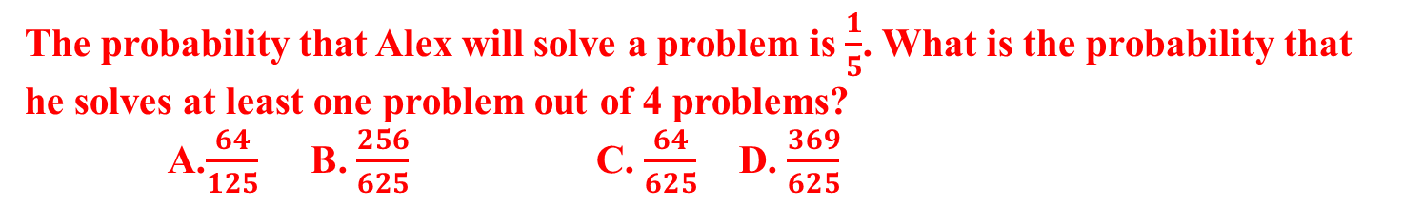
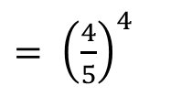





PRACTICE QUESTION
The probability that Alex will solve a problem is $\frac{1}{5}$. What is the probability that he solves at least one problem out of 4 problems?
A.$\frac{64}{125}$ B. $\frac{256}{625}$ C. $\frac{64}{625}$ D. $\frac{369}{625}$
Given, the probability that Alex will solve a problem
$=\frac{1}{5}$
so, the probability that Alex will not solve a problem
$−\frac{1}{5}$
$$=\frac{4}{5}$$
= 1
$= {\left(\frac{4}{5}\right)}^{4}$
The probability that Alex will not solve any problems
$=\frac{256}{625}$.
Hence, the probability that Alex will solve at least one problem
$= 1 −\frac{256}{625}$.
$=\frac{369}{625}$
Ans D

Slide 48
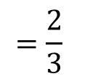
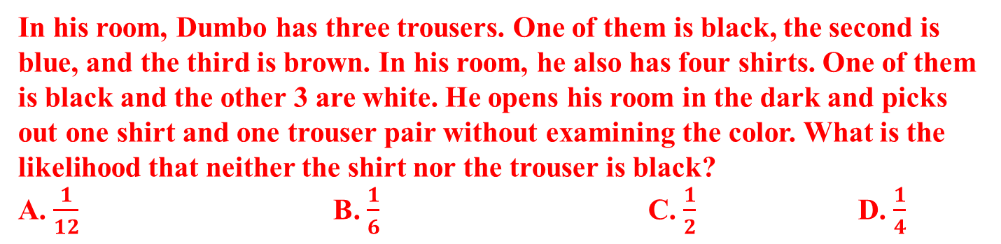

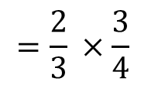

PRACTICE QUESTION
In his room, Dumbo has three trousers. One of them is black, the second is blue, and the third is brown. In his room, he also has four shirts. One of them is black and the other 3 are white. He opens his room in the dark and picks out one shirt and one trouser pair without examining the color. What is the likelihood that neither the shirt nor the trouser is black?
A. $\frac{1}{12}$ B. $\frac{1}{6}$ C. $\frac{1}{2}$ D. $\frac{1}{4}$
$$=\frac{2}{3}$$
Probability that trouser is not black
Probability that shirt is not black
$=\frac{3}{4}$
Required probability
$$=\frac{2}{3} ×\frac{3}{4}$$
$=\frac{1}{2}$

Slide 49
PRACTICE QUESTION
A bag contains 2 red, 3 green and 2 blue balls. Two balls are drawn at random. What is the probability that none of the balls drawn is blue?
A. $\frac{10}{21}$ ` B. $\frac{11}{21}$ C. $\frac{2}{7}$ D. $\frac{5}{7}$
Here, Total number of balls
$$=7 Balls$$
$$=2R+3G+2B$$
Let n(S) Number of ways of drawing 2 balls out of 7
$$n\left(S\right)={{}_{}^{7}C}_{2}$$
$$n\left(S\right)=\frac{7×6}{1×2}$$
$$=21$$
Let E = Event of drawing 2 balls, none of which is blue.
$$n\left(E\right)={{}_{}^{5}C}_{2}$$
$$n\left(E\right)=\frac{5×4}{1×2}$$
$$=10$$
$$=\frac{n(E)}{n(S)}$$
$$=\frac{10}{21}$$
Required probability

Slide 50
Mensuration
By:-
Naveen Kumar Jain
(Aptitude Trainer)

Slide 51
1. If the side of an equilateral triangle is 4 cm, find its area and perimeter.
A. 6.928 cm2, 12cm B. 6 cm2, 12cm C. 6.928 cm2, 5 cm D. None of these

Slide 52
2. If three sides of a triangle are 5, 6, 7 cm respectively, find the area of triangle.
A. 6√3 cm² B. 6√6 cm² C. 3√6 cm² D. 3√2 cm²

Slide 53
3. If a rectangular paper of length 6 cm and width 3 cm is rolled to form a cylinder with height equal to the width of the paper, then its base radius is
A. 3/π B. 5/π C. 7/π D. 9/π

Slide 54
4. The sides of a triangle are in the ratio of 5:4:3. If its perimeter is 24 cm, what is the area of the triangle?
A. 22 cm² B. 24 cm² C. 26 cm² D. 28 cm²

Slide 55
5. The two adjacent sides of a parallelogram are 12 and 14 meters respectively, and if the diagonal connecting the ends is 22 meters, find the area of the parallelogram.
A. 150 m² B. 145 m² C. 151.78 m² D. None of these

Slide 56
6. The length of a rectangle is increased by 30% and its breadth is decreased by 20%. What is the percentage change in the area?
A. 4 % B. 6 % C. 8 % D. 10 %

Slide 57
7. The diameter of a circle is doubled. Its area becomes times?
A. 4 B. 2 C. 6 D. 8

Slide 58
8. There is a path of 1 m wide around the outer edge of a circular part of 10 m radius. What is the path area?
A. 66 sq m B. 55 sq m C. 45 sq m D.68 sq m

Slide 59
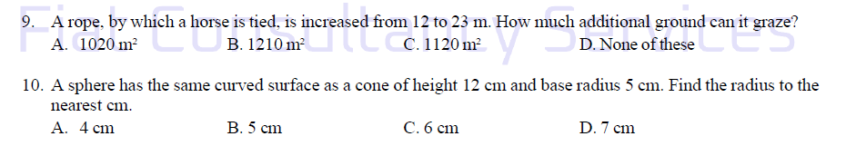

Slide 60


Slide 61


Slide 62


Slide 63


Slide 64


Slide 65
THANK YOU

